Slide 1
ميهاربا بحاص ةدايم م.م
تابساح \ىلولاا ةلحرملا
Example(1):- Write a C++ program to printe the massege.
Example(2):- Write a C++ program to read two integer numbers, then find their sum?
Solution
#include <iostream.h>
int main()
{
int integer1, integer2, sum; cout << "Enter first integer\n"; cin >> integer1;
cout << "Enter second integer\n"; cin >> integer2;
sum = integer1 + integer2;
cout << "Sum is " << sum << endl; return 0;

Slide 2
ميهاربا بحاص ةدايم م.م
تابساح \ىلولاا ةلحرملا
Example(3):- write a C++ program that computes the area of rectangle with given fixed lengh and width?
Solution:-
#include <iostream.h> int main()
{
int lengh, width, area; lengh=4;
width=5; area=lengh* width;
cout<< '' the area of rectangle is:" <<area<<end1; return 0;
}Example(4) :- write a C++ program that reads the lengh and width of a rectangle, and prints its area?
Solution:-
#include <iostream.h>
void main()
{
int lengh, width, area;
cout<< "enter lengh:"<<end1; cin>> lengh;
cout<< "enter width :"<<end1; cin>> width;
area=lengh* width;
cout<< '' the area of rectangle is:" <<area<<end1;
return 0;}

Slide 3
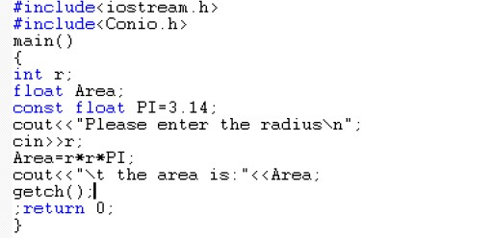
ميهاربا بحاص ةدايم م.م
تابساح \ىلولاا ةلحرملا
Example(5) :- write a C++ program that reads the radius of a circle and prints its area?
Solution:-
H.W// write a C++ program that reads the height and base of a triangle and prints its area?

Slide 4
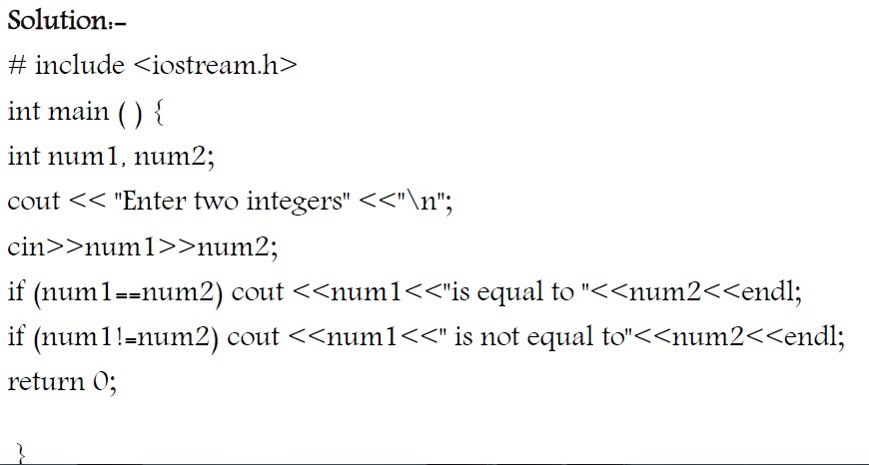
ميهاربا بحاص ةدايم م.م
تابساح \ىلولاا ةلحرملا

Slide 5
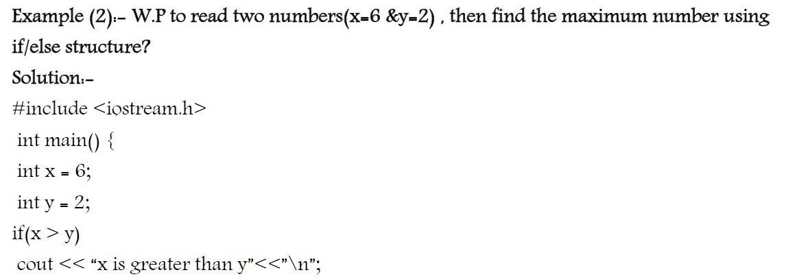
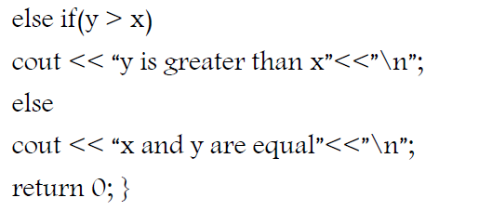
ميهاربا بحاص ةدايم م.م
تابساح \ىلولاا ةلحرملا

Slide 6
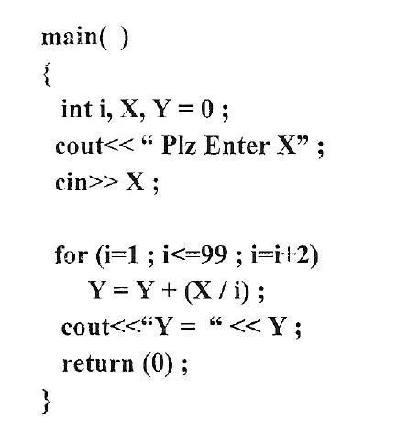
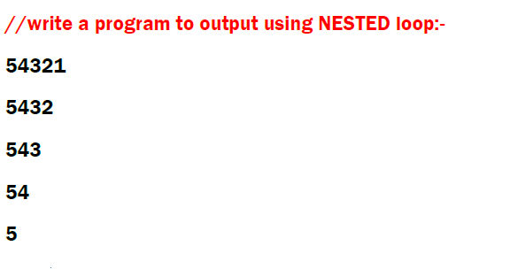
ميهاربا بحاص ةدايم م.م
تابساح \ىلولاا ةلحرملا

Slide 7
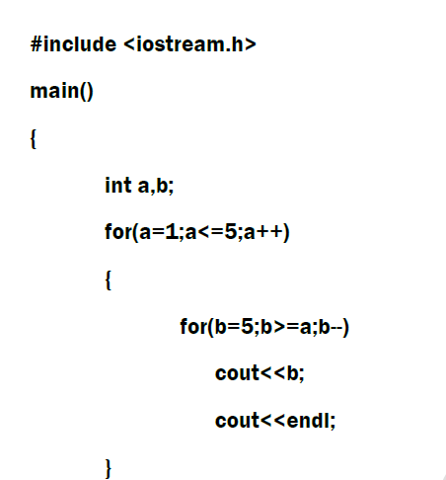
ميهاربا بحاص ةدايم م.م
تابساح \ىلولاا ةلحرملا

